Slide 1





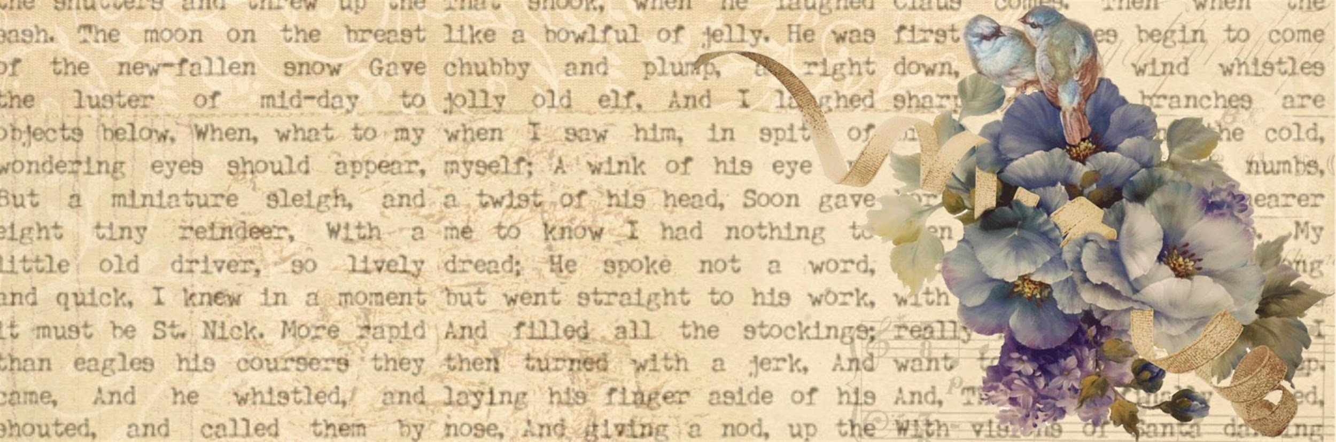






Sentence Completion

Slide 2
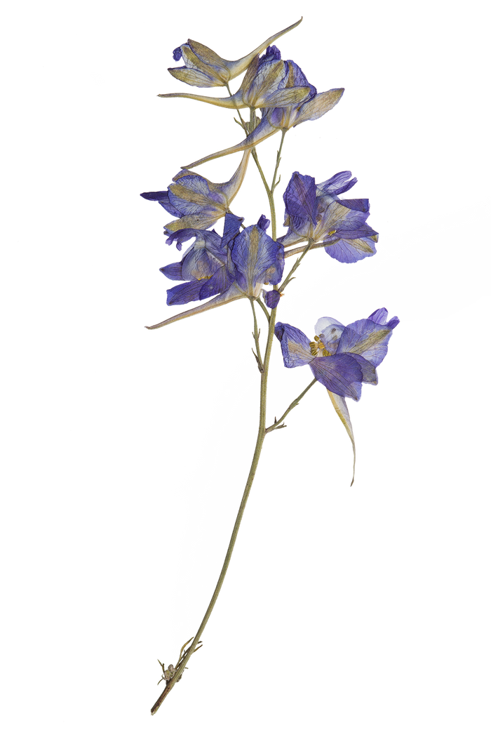
Connectors and Signal words
Indicators for Cause and Effect (has already been discussed)
Indicators for Contrast
Indicators for Similarity
Indicators for Restatement

Slide 3
Indicators for Contrast
Zahid looks a noble person but he always becomes _______ any good deed.
a) supporter of
b) obstacle for
c) swift to do
d) promoter for

Slide 4
Indicators for Contrast
Zahid looks a noble person but he always becomes _______ any good deed.
a) supporter of
b) obstacle for
c) swift to do
d) promoter for

Slide 5
Indicators for Contrast
She enjoys swimming ___________ she finds it tiring sometimes.
A) although
B) however
C) despite
D) on the other hand

Slide 6
Indicators for Contrast
She enjoys swimming ___________ she finds it tiring sometimes.
A) although
B) however
C) despite
D) on the other hand

Slide 7
Indicators for Contrast
He studied diligently; ___________, he failed the exam.
A) despite
B) although
C) however
D) on the contrary

Slide 8
Indicators for Contrast
He studied diligently; ___________, he failed the exam.
A) despite
B) although
C) however
D) on the contrary

Slide 9
Indicators for Contrast
___________ the bad weather, the event went ahead as planned.
A) Despite
B) Although
C) However
D) On the contrary

Slide 10
Indicators for Contrast
___________ the bad weather, the event went ahead as planned.
A) Despite
B) Although
C) However
D) On the contrary

Slide 11

Other Indicators for for Contrast can be…
though
on the other hand
on the contrary
despite
although
however
while
instead of
still

Slide 12
Indicators for Similarity
Lahore city council representative promised that he would consider all suggestions from downtown residents and that he was willing; not only to discuss his proposal, but also to ____
it.
a) change
b) vanish
c) accept
d) disapprove

Slide 13
Indicators for Similarity
Lahore city council representative promised that he would consider all suggestions from downtown residents and that he was willing; not only to discuss his proposal, but also to ____
it.
a) change
b) vanish
c) accept
d) disapprove

Slide 14
Indicators for Similarity
He enjoys playing soccer; ___________, his brother prefers basketball.
A) like
B) thereafter
C) in the same way
D) resembles

Slide 15
Indicators for Similarity
He enjoys playing soccer; ___________, his brother prefers basketball.
A) like
B) thereafter
C) in the same way
D) resembles

Slide 16
Indicators for Similarity
___________ her sister, she excels in mathematics.
A) In the same way
B) Like
C) Similarly
D) Resembles

Slide 17
Indicators for Similarity
___________ her sister, she excels in mathematics.
A) In the same way
B) Like
C) Similarly
D) Resembles

Slide 18
Other Indicators for Similarity can be…
in the same way
like
similarly
resembles
in the same way
for example
for instance
such as
specifically

Slide 19
Indicators for Restatement
Just as people of Multan are doing their best to eradicate the social evils like family marriages,
so the people of Bahawalpur are making efforts _______ the penetration of foreign culture
in their social norms.
a) to absorb
b) to accept
c) to normalize
d) to stop

Slide 20
Indicators for Restatement
Just as people of Multan are doing their best to eradicate the social evils like family marriages,
so the people of Bahawalpur are making efforts _______ the penetration of foreign culture
in their social norms.
a) to absorb
b) to accept
c) to normalize
d) to stop

Slide 21
Indicators for Restatement
The results were disappointing; __________, they did not meet expectations.
A) as in fact
B) in short
C) just as
D) that is

Slide 22
Indicators for Restatement
The results were disappointing; __________, they did not meet expectations.
A) as in fact
B) in short
C) just as
D) nevertheless

Slide 23
Other Indicators for Restatement can be…
that is
in short
just as
as in fact

Slide 24
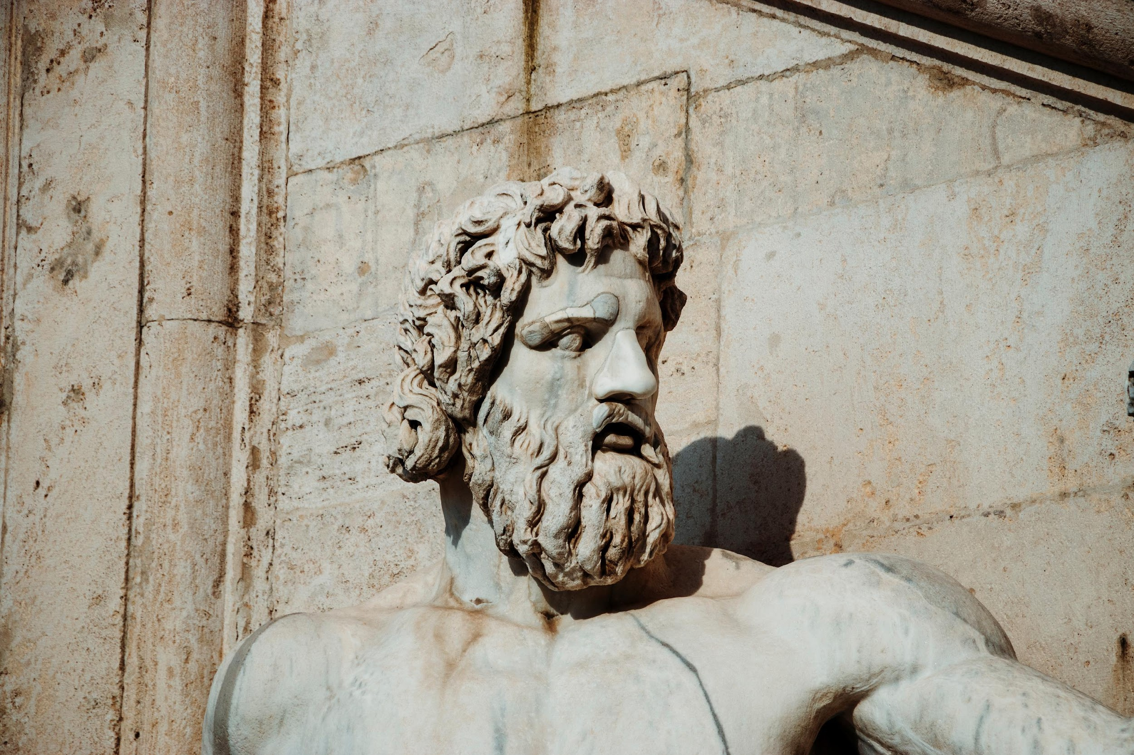

Four Step Process for Sentence completion

Slide 25

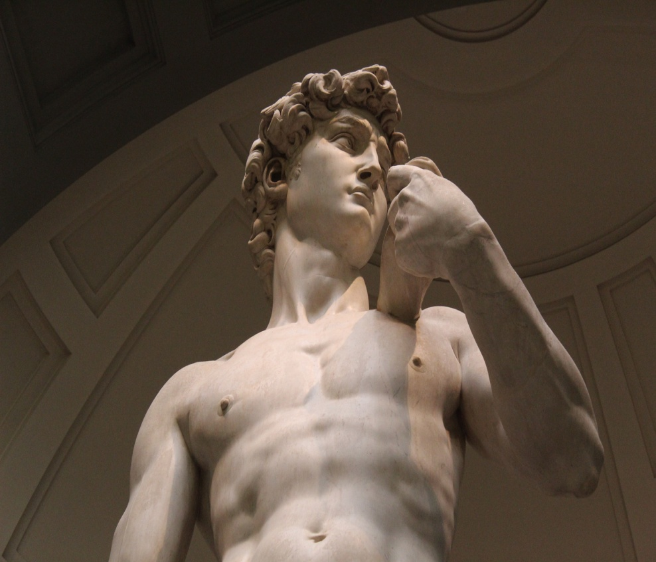
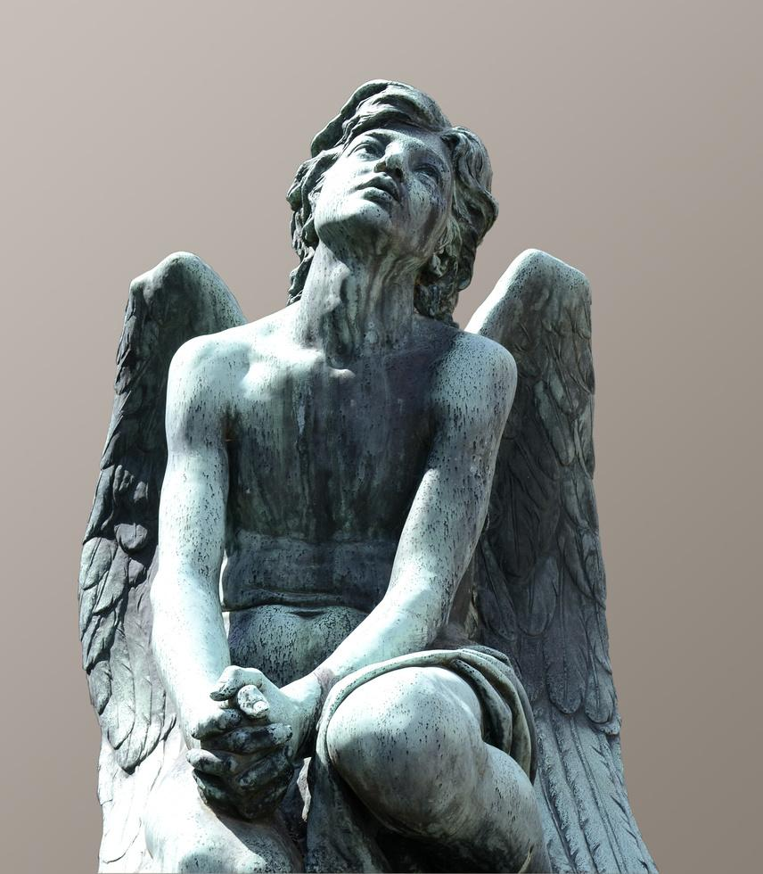

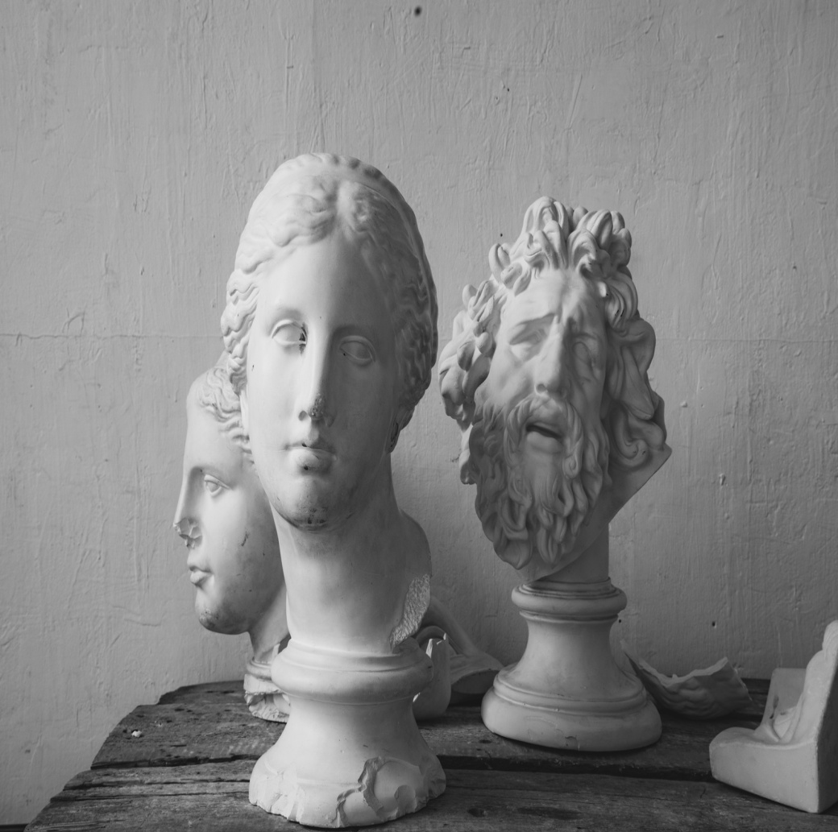
Anticipating Words: This implies anticipating the meaning of the word/s that will be filled in the blanks appropriately and in particular, that it should be in sync with what the author’s message and tone are.
The Final Answer: Reread the sentence with your answer choice. If you find that everything matches, then you have got the correct answer to the question.
STEP 3
STEP 1
STEP 2
STEP 4
Scanning: Try each answer choice in the blank to see which one suits the best.
Understand the Message and the Tone of the Author:
Understanding the Message
Identify the Logical Structure of the Sentence
Understanding the Tone

Slide 26

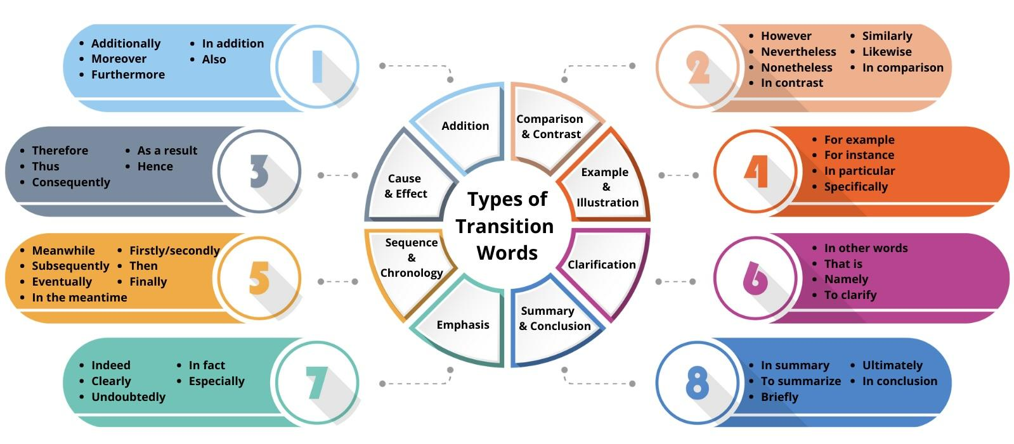
Types of Transition Words

Slide 27
Thank
you

